Slide 1

Guru Gobind Singh College of Engineering and Research Center, Nashik.
Department of Computer Engineering
Academic Year: 2023-24
Final Year Project Work
Review 3
Date : 12 Oct 2023
Group ID | G - 2
Project Title | Civil complaints registering application for citizens of Rural/Urban areas.
Team Members | 1. Tejas Bhandare
 | 2. Ishan Ahirrao
 | 3. Rohit Bava
Guide Name | Prof. S. G. Shukla

Slide 2

Presentation Outline :
Feasibility
Requirement Analysis
System Architecture
Class Diagram
Use Case Diagram
Object Diagram
Guru Gobind Singh College of Engineering, Nashik

Slide 3
Feasibility
The system will leverage automation technology, including Machine Learning (ML), Data Science, Computer Vision and Image Processing, to streamline the process of addressing citizen complaints related to waste materials, road path holes, pipelines, drainage systems, and various other urban and rural issues.
Feasibility Aspects:
Technical Feasibility :
Technology stack
Image processing capabilities
Integration with geographic information systems (GIS)
Economic Feasibility
Operational Feasibility
Guru Gobind Singh College of Engineering, Nashik

Slide 4
Requirement Analysis:
Hardware Requirement :
Laptop/PC with recent hardware and software released stable versions.
4G/5G Smartphone.
Software Requirement :
Visual Studio Code, Flutter, Dart latest released stable versions.
Datasets:
Municipal corporation’s Geofencing dataset.
Civil complaint Classes dataset.
Local authorities hierarchy dataset.
Historical civil complaints dataset.
Guru Gobind Singh College of Engineering, Nashik

Slide 5
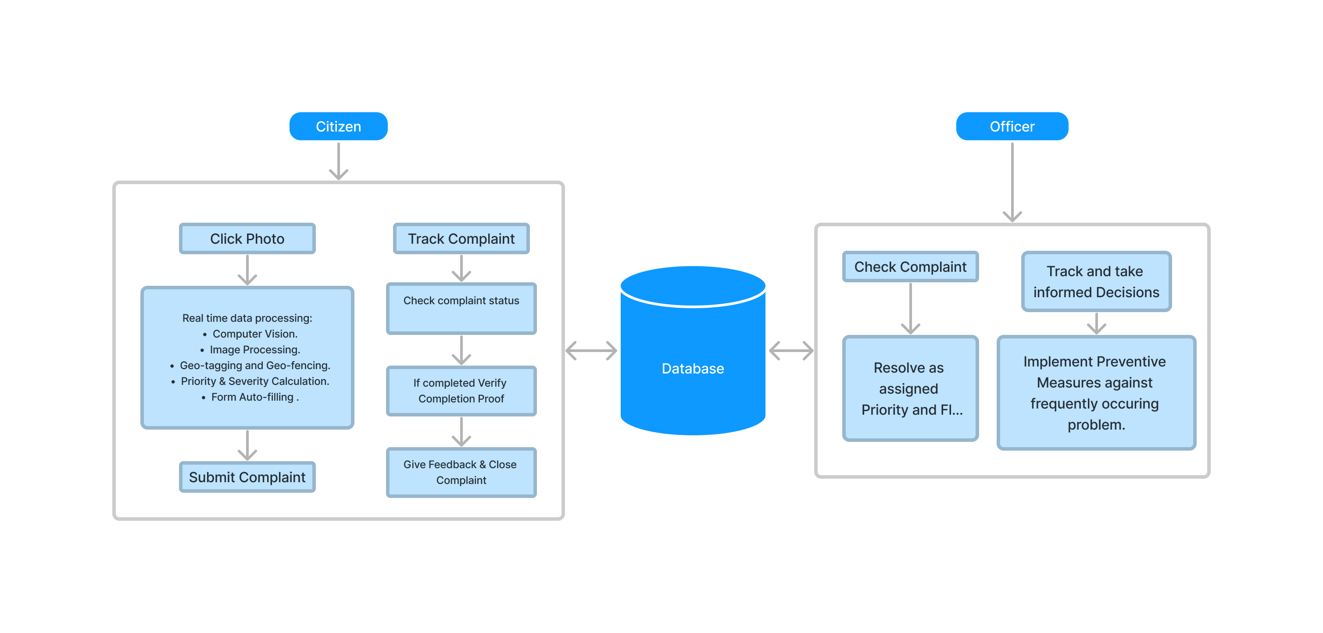
System Architecture:
Guru Gobind Singh College of Engineering, Nashik

Slide 6
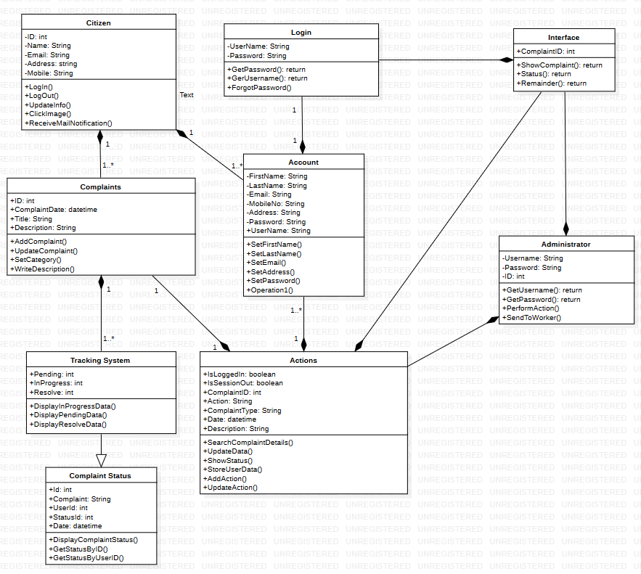
Class Diagram
Guru Gobind Singh College of Engineering, Nashik

Slide 7
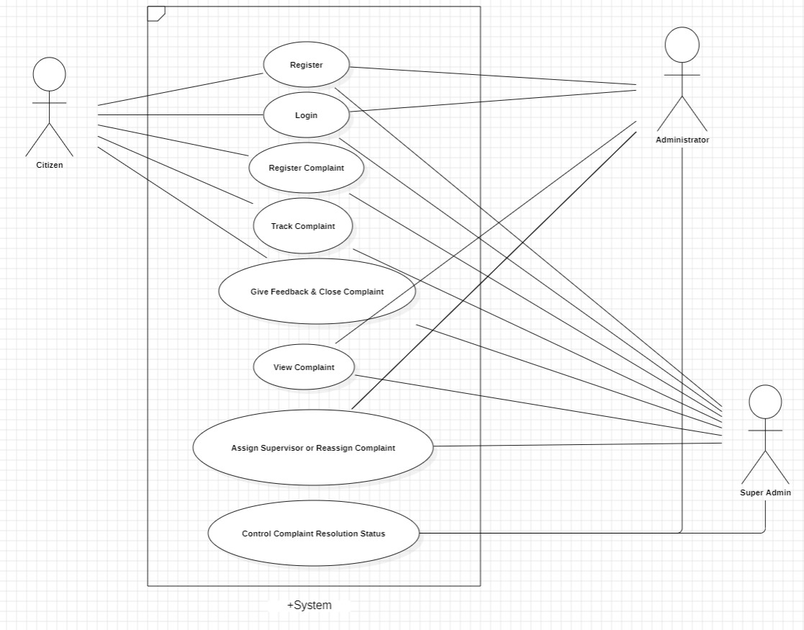
Use Case Diagram:
Guru Gobind Singh College of Engineering, Nashik

Slide 8
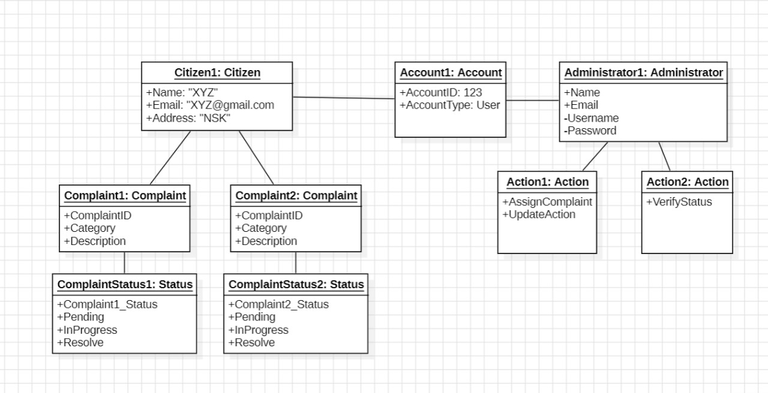
Object Diagram:
Guru Gobind Singh College of Engineering, Nashik

